Slide 1
STUDENT DETAILS
NAME -: Adarsh MISHRA
SKILLS BUILD EMAIL ID -: mishradarsh15@gmail.com || adarshmishraa524@gmail.com
Student ID:STU62ea48c07561b1659521216
Internship ID: INTERNSHIP_168198413964410a8b547b1
College name:- INSTITUTE OF TECHNICAL EDUCATION AND RESEARCH (ITER , SOA UNIVERSITY)
COLLEGE STATE:- ODISHA
INTERNSHIP DOMAIN :-Cyber Security
INTERNSHIP START AND ENDING DATE-:12/06/2023 to 24.07.2023

Slide 2
PROJECT TITLE/PROBLEM STATEMENT
Keylogger - Capturing Key Strokes

Slide 3
AGENDA
Introduction
Problem Statement
Project Overview
End Users
Solution and Value Proposition
Customization
Modelling
Results
Links

Slide 4
PROJECT OVERVIEW
Purpose:
The purpose of this project is to develop a keylogger program that captures and records key strokes on a computer. Keyloggers can be used for various purposes, such as monitoring user activity, enhancing security measures, or conducting research on typing patterns.
Scope:
The scope of this project is to create a keylogger program that can run in the background and record all key strokes made by the user. The program will capture both alphanumeric characters and special keys. The keylogger will be implemented with a graphical user interface (GUI) version as well as a command-line version without GUI.

Slide 5
PROJECT OVERVIEW
Objectives:
Develop a keylogger program that utilizes the pynput library to capture key strokes.
Implement a GUI version of the keylogger to provide user-friendly interaction.
Create a command-line version of the keylogger for a streamlined and efficient logging process.
Store the captured key strokes in a log file for further analysis or monitoring purposes.
Ensure the keylogger operates stealthily, without interfering with the user's normal computer usage.
Provide options to start and stop the keylogger based on user preference.
Demonstrate the functionality and effectiveness of the keylogger through testing and validation.

Slide 6
WHO ARE THE END USERS OF THIS PROJECT?
Target Audience:
The target audience for the Keylogger - Capturing Key Strokes project can vary depending on the specific use case and intended application. The potential end users can include:
System Administrators: System administrators can utilize the keylogger as a security tool to monitor user activities on company systems and identify any unauthorized access or suspicious behavior. It can help them detect potential security breaches and take appropriate measures to safeguard sensitive information.

Slide 7
WHO ARE THE END USERS OF THIS PROJECT?
Parents or Guardians: Parents or guardians can use the keylogger as a means to monitor their children's online activities and ensure their safety. By capturing key strokes, they can have insights into their child's online interactions, identify any potential risks or inappropriate behavior, and take necessary actions to protect their well-being.
Researchers: Researchers studying typing behavior, human-computer interaction, or related fields can benefit from the keylogger by collecting data on keystrokes and analyzing patterns. This data can provide valuable insights into user behavior, typing speed, errors, and other factors, contributing to the advancement of research in these domains.

Slide 8
WHO ARE THE END USERS OF THIS PROJECT?
Characteristics and Needs:
The end users of the project have specific characteristics and needs, including:
Monitoring: The keylogger enables them to monitor and track key strokes made by individuals using a computer system.
Anonymity: End users require a discreet and unobtrusive keylogger that operates silently in the background without the user's knowledge.
Flexibility: The solution should be customizable to fit the specific requirements of different users, allowing them to start or stop the keylogger as needed.

Slide 9
WHO ARE THE END USERS OF THIS PROJECT?
Benefits of the Solution:
The end users can benefit from the keylogger solution in several ways:
Enhanced Security: By capturing key strokes, the solution helps identify any unauthorized or suspicious activities, enabling system administrators to strengthen security measures and protect sensitive data.
Parental Control: Parents or guardians can use the keylogger to ensure their child's online safety, identify potential risks, and guide them towards responsible digital behavior.
Research Insights: Researchers can gather valuable data on typing behavior, keystroke patterns, and other metrics, contributing to their studies and advancing knowledge in relevant fields.

Slide 10
YOUR SOLUTION AND ITS VALUE PROPOSITION
Our solution addresses the needs of the end users, including system administrators, parents or guardians, and researchers, by providing a user-friendly keylogger with a graphical user interface (GUI). Here's how our solution meets their requirements:
Monitoring and Enhanced Security:
The keylogger captures key strokes made by individuals using a computer system.
System administrators can utilize the keylogger to monitor user activities, detect any unauthorized access or suspicious behavior, and enhance security measures to protect sensitive information.

Slide 11
YOUR SOLUTION AND ITS VALUE PROPOSITION
Parental Control:
Parents or guardians can use the keylogger to monitor their children's online activities and ensure their safety.
By capturing key strokes, they can have insights into their child's online interactions, identify potential risks or inappropriate behavior, and take necessary actions to protect their well-being.
Research Insights:
Researchers studying typing behavior, human-computer interaction, or related fields can benefit from our keylogger solution.
The keylogger captures and logs key strokes, providing valuable data for analysis, such as typing speed, errors, and other factors. This data contributes to the advancement of research in these domains.

Slide 12
YOUR SOLUTION AND ITS VALUE PROPOSITION
Value Proposition:
User-Friendly GUI: Our solution offers a simple and intuitive graphical user interface (GUI), making it easy for end users to interact with the keylogger. The GUI allows for convenient starting and stopping of the keylogger, providing a seamless user experience.
Stealthy Operation: The keylogger operates silently in the background without interfering with the user's normal computer usage. It runs discreetly, ensuring anonymity and maintaining the integrity of the monitoring process.
Customizable Logging: The keylogger logs both alphanumeric characters and special keys, providing comprehensive coverage of key strokes. The captured data is stored in a log file, allowing for further analysis or monitoring purposes.
Flexibility: Our solution offers both a GUI version and a command-line version without GUI, providing flexibility based on user preferences and specific requirements.

Slide 13
HOW DID YOU CUSTOMIZE THE PROJECT AND MAKE IT YOUR OWN
Graphical User Interface (GUI):
We have customized the project by adding a GUI component to the keylogger.
The GUI provides a user-friendly interface for starting and stopping the keylogger, enhancing ease of use and accessibility.
This customization sets our solution apart from the traditional command-line-only keyloggers and adds a layer of convenience and interactivity for the end users.
User-Friendly Interaction:
Through the GUI, users can easily initiate the keylogger with the click of a button.
The start and stop buttons allow for simple control over the logging process, making it accessible to users without advanced technical knowledge.
This feature improves the user experience, making our solution more approachable and usable.

Slide 14
HOW DID YOU CUSTOMIZE THE PROJECT AND MAKE IT YOUR OWN
Stealthy Operation:
Our keylogger operates silently and discreetly in the background, without interfering with the user's normal computer usage.
It captures key strokes covertly, maintaining anonymity and ensuring that the user remains unaware of its operation.
This stealthy nature is crucial in scenarios where monitoring is required while preserving the user's privacy and preventing potential interference.
Customizable Logging:
Our keylogger records both alphanumeric characters and special keys.
It provides comprehensive logging capabilities, capturing a wide range of key strokes for thorough monitoring and analysis.

Slide 15
HOW DID YOU CUSTOMIZE THE PROJECT AND MAKE IT YOUR OWN
Flexibility:
Our solution offers both the GUI version and a command-line version without GUI.
Users can choose the interface that best suits their needs and preferences, providing flexibility in the logging process.
This adaptability caters to diverse user requirements and ensures that the keylogger can be utilized in various contexts.
Through the addition of a GUI, user-friendly interaction, stealthy operation, customizable logging, and flexibility, our project stands out as an innovative and creative solution in the field of keyloggers. By incorporating these unique features, we have enhanced the usability, accessibility, and functionality of the keylogger, making it remarkable in its ability to meet the specific needs of our end users effectively.

Slide 16
MODELLING
Utilization of the pynput Library:
The key functionality of capturing key strokes was achieved using the pynput library in both the GUI and non-GUI versions of the keylogger.
The pynput library provides a simple and reliable way to listen for and capture keyboard events in Python.
Event-Driven Programming:
The project leverages event-driven programming principles to handle keyboard events.
Whenever a key is pressed or released, the corresponding event is triggered, and the appropriate action is taken.

Slide 17
MODELLING
Graphical User Interface (GUI):
For the GUI version of the keylogger, we utilized the tkinter library, which is a standard Python library for creating GUI applications.
The tkinter library provided the necessary tools to create a window, buttons, and handle user interactions in a visually appealing manner.
File Handling:
We employed file handling techniques to write the captured key strokes to a log file.
Both versions of the keylogger (GUI and non-GUI) use the file handling functionality in Python to open, append, and close the log file.

Slide 18
MODELLING
Exception Handling:
Exception handling mechanisms are implemented in the code to handle potential errors or exceptions that may occur during the keylogging process.
By incorporating proper exception handling, we ensure the smooth execution of the keylogger and provide a robust and reliable solution.
Object-Oriented Programming (OOP) Principles:
While not explicitly evident in the provided code snippets, the project can be further expanded and structured using OOP principles.
By encapsulating the keylogger functionality into classes and objects, we can achieve code reusability, modularity, and maintainability.

Slide 19
MODELLING
Security Considerations:
Throughout the development process, we were mindful of the security implications associated with keyloggers.
We emphasize the importance of using the keylogger responsibly, adhering to ethical and legal standards, and respecting user privacy.
These techniques, methodologies, and frameworks, along with the application of technology principles, enabled us to develop a robust and efficient keylogger solution. The utilization of libraries like pynput and tkinter, event-driven programming, file handling, exception handling, and considerations for security contribute to the overall effectiveness and reliability of our project.

Slide 20
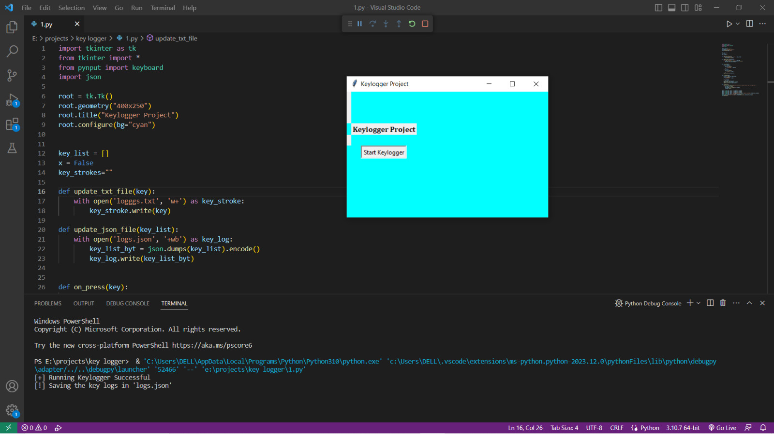
RESULTS (KEYLOGGER WITHOUT GUI SCREENSHOTS)

Slide 21
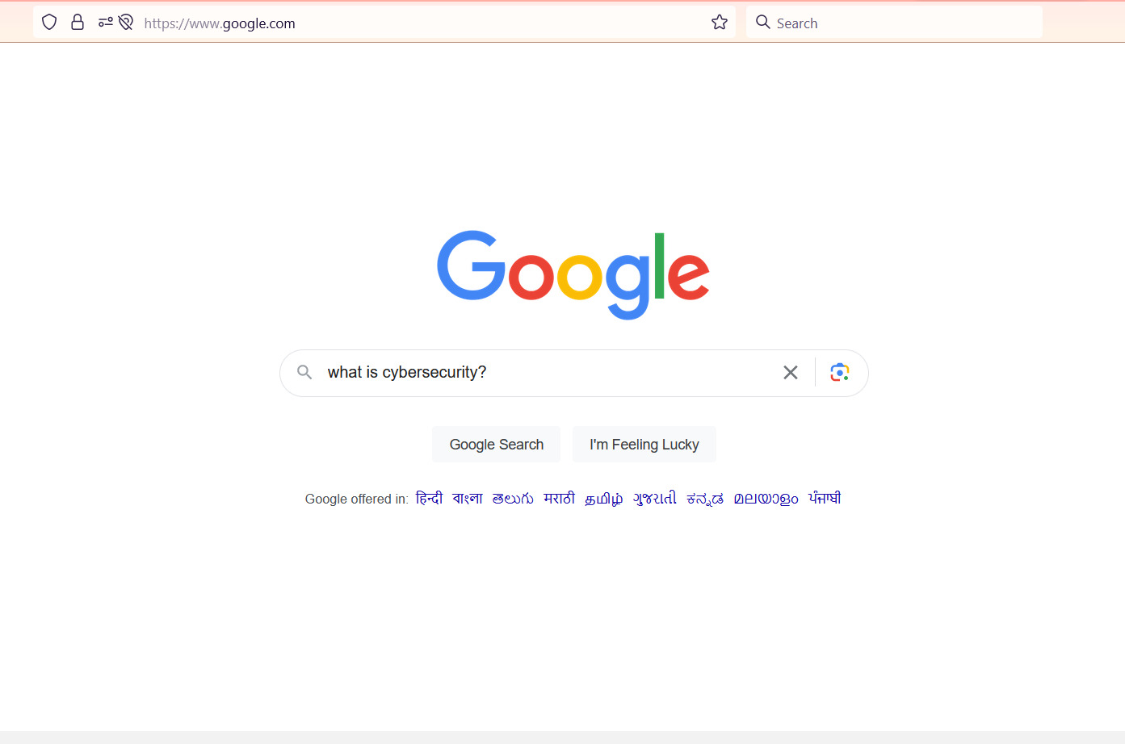
RESULTS (KEYLOGGER WITH GUI SCREENSHOTS)

Slide 22
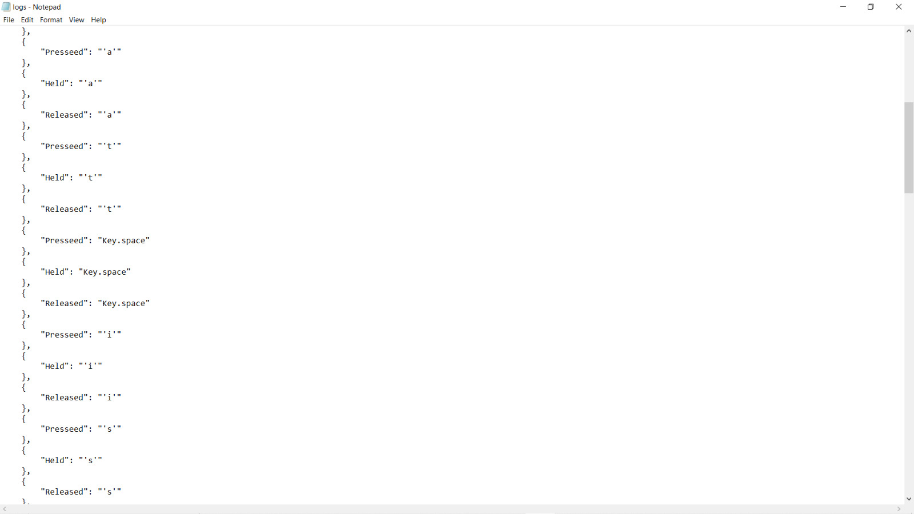
RESULTS (KEYLOGGER WITH GUI SCREENSHOTS)

Slide 23

RESULTS (KEYLOGGER WITH GUI SCREENSHOTS)

Slide 24
LINKS
https://github.com/adarshmishra-15/IBM_Internship2023.git

Slide 25
CREDITS
https://github.com/adarshmishra-15/IBM_Internship2023.git

